Slide 1
Universal Healthcare System
Health Care That Care
Welcome!!
Having Universal Healthcare Saves Everyone

Slide 2

UNIVERSAL HEALTHCATRE SYSTEM
Supervisor: Dr. Md. Rajibul Islam.
Assistant Professor (Dept. of CSE)
University of Asia Pacific.

Slide 3
TABLE OF THE CONTENT
01
Introduction
02
Application
03
E- Healthcare Service
04
Platform
05
Our services
06
Our Gallery
07
Trouble Shooting
08
Future Work
09
Conclusion

Slide 4
Let’s Start

Slide 5

INTRODUCTION
What is Healthcare System?
The term healthcare system refers to a country’s system of developing services for the prevention and treatment of diseases and for the promotion of physical and mental wellbeing.
A county’s healthcare system also reflects in part of the culture and values of the society.
Teeth
Eye
Blood
Better teeth
better health
One eye,
sees,
The other ,
feel
Every Drop
Counts
Gives blood
Today

Slide 6
APPLICATION
01
Patient Personal Information
02
Department Type
03
24 Hours Patient Services
04
World Class Services
05
Uses Modern Technology
06
Super Fast Online Services

Slide 7



E-Healthcare Services
Patient can make an appointment by using E-Healthcare Service. Also get free membership by creating an account.
This service is the most populated and efficient. People get fastest ambulance service by using the E-Healthcare service.

Slide 8
PLATFORM
SOFRWARE
DATABASE
Mozilla Firefox
MYSQL
LANGUAGE
SERVER
XAMPP
PHP
HTML
JAVA
CSS

Slide 9
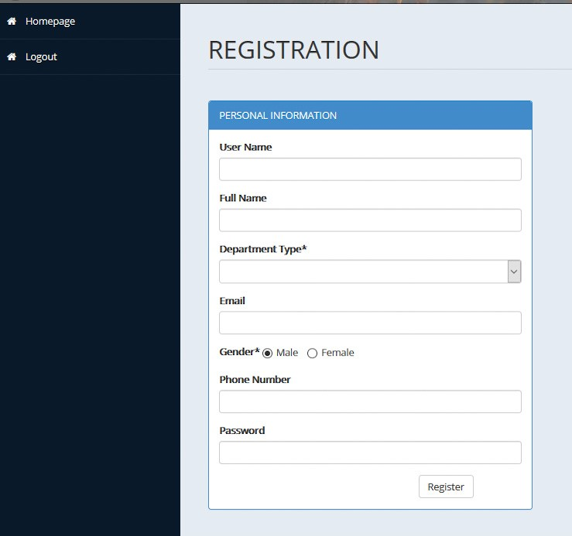
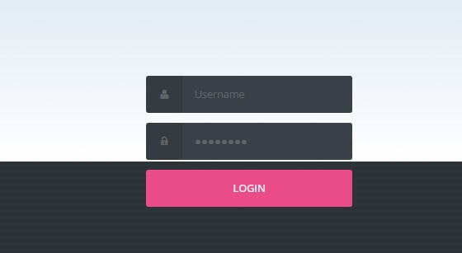
Strong Security and Easy Access

Slide 10
Our Services
Universal Healthcare System
ORTHOPAEDICS
RADIOLOGY
SKIN
DENTAL
SURGERY
COSMETIC-SURGERY
CARDILOGY
DIABETOLOGY
EMERGENCY
DIET & NUTRITION

Slide 11
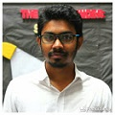

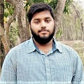
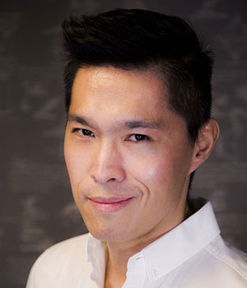
Our Team
Dr. Mr. Sherlock Holmes
Dr John H. Watson
CHAIRMAN
MANAGING DIRECTOR
Founder of Universal Healthcare & governing body.
MBBS (Dha), FCPS (BD), FRCS (Glasg.), FRCS (Edin), D Uro (London), FWHO (Uro)
Prof. Dr. Moriarty
Prof. Dr. Zarif Khan Mojlish
EXECUTIVE DIRECTOR
DIRECTOR
MBBS (Dha), FCPS (BD), FRCS (Glasg.), FRCS (Edin).
MBBS (Dha), FCPS (BD), FRCS (Glasg.), FRCS (Edin).

Slide 12
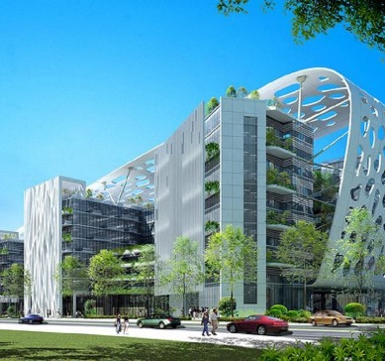


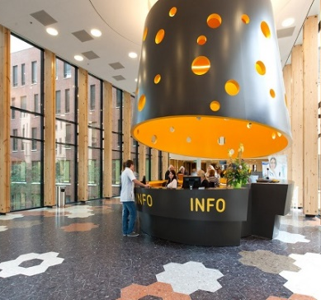
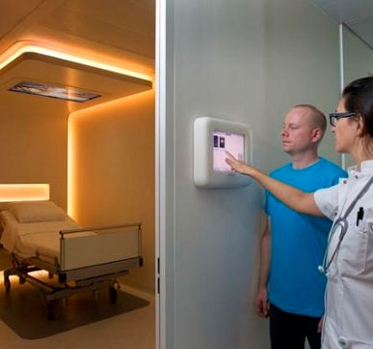

Our Gallery
Our Happiness

Slide 13

TROUBLE SHOOTING
Database Connecting
PHP Error
CSS Error

Slide 14

FUTURE WORK
Developed The Project in Future:-
Improve security System
By Using Java
By Using CSS
By Using HTML
By Using PHP
Using Graphics Designing
Navigating Healthcare Services
Improve services

Slide 15
CONCLUSION
Insert the title of your subtitle Here
Patient Profile
Increase Efficiency
Patient history and reports and all other information are provided.
In future the project will be developed with more efficiencies.
Strong Security
Easy Access
The information are kept very secure that only admin will control.
One person can easy access and get a specialist of any department, also get online services.

Slide 16
Thank you

